Slide 1
ICBGM 2012
Modeling Chemical Reactions Using Bond Graphs
Jürgen Greifeneder and François Cellier / Genua / July 2012
Notes:
1

Slide 2
Modeling Chemical Reactions Using Bond Graphs
Starting Point
Methodology to model
  Conduction
  Convection
  Evaporation / Condensation
  Multi-Element Systems
using true rather than pseudo-bond graphs
➔ Chemical reactions are the final high point to this methodology

Slide 3
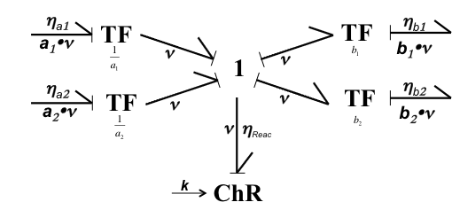
Modeling Chemical Reactions Using Bond Graphs
Basics
A₁
B₁
A₂
B₂
A_{i}
Chemical Reaction
B_{j}
T
p
heat
volume work
Unknowns

Slide 4
Modeling Chemical Reactions Using Bond Graphs
How to compute reaction rate k and molar flow rate ν?
Using Arrhenius’ law:
This requires us to provide
  the temperature T
  the molar fractions of each of the components within the mixture
η^{Reac}
Τ
ChR
ν
{c₁, c₂, …, c_{k}}

Slide 5
Modeling Chemical Reactions Using Bond Graphs
How to compute T and p?
Each component has its mass, fills an individual volume and holds an individual amount of entropy
This is enough to determine the state of each component → {M, S, V}
Temperature and pressure are intrinsic variables, i.e.
This leads to a new capacitive element, called “capacitive field” (CF) compounding three different extrinsic state variables
=

Slide 6
Modeling Chemical Reactions Using Bond Graphs
Equilibrium Processes
All CF-Elements are connected using HVE-Elements
HVE contains independent equilibrium processes for temperature and pressure
Allowing any exchange speeds for heat resp. volume
  T & p of neighboring CFs will equalize over time
  T & p of CFs within a mixture will vary only marginal, e.g. in heating or expanding processes
T & p of a mixture can be (as a first order approximation) calculated as weighted average of the components Ts & ps

Slide 7
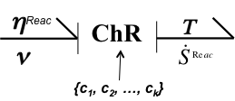
Modeling Chemical Reactions Using Bond Graphs
What is η?
Free Gibb‘s Enthalpy per kg
Free Gibb‘s Enthalpy per mol
g
TF
μ
.
M
m
ν
Mass flow
Molar flow
Internal Energy per kg
Internal Energy per mol
u
TF
η
.
M
m
ν

Slide 8
Modeling Chemical Reactions Using Bond Graphs
How to compute η?

Slide 9
Modeling Chemical Reactions Using Bond Graphs
How to distribute S^{reac} ?
.
Assumption:
heat is transferred over surfaces, i.e. the larger the volume fraction of a component the larger is the probability that this component’s surface is in contact to the heat source (reaction)
➔ Distribute the reaction’s heat production / consumption towards all components linear to their volume fraction.

Slide 10
Modeling Chemical Reactions Using Bond Graphs
How to deal with the chemical volume work q^{Reac}?
Δp₁
q₁
p₂
p₂
Δp₂
0
1
q₂
q₂
q₂
Classical Difference Calculation:
p*
To the chemical reaction network
Δp₁
q₁
q₂
From CF-Element
p₁
p*
p*
1
q₃
0
1
0
q₃
q₁
q₁
Δp₃
q₃
p₃
q₃
0
p₃
Boyle-Mariotte
Δq^{Reac}
p*
To be distributed towards the CF-Elements

Slide 11
Modeling Chemical Reactions Using Bond Graphs
Volume Distribution (Bond Graph Schema)

Slide 12
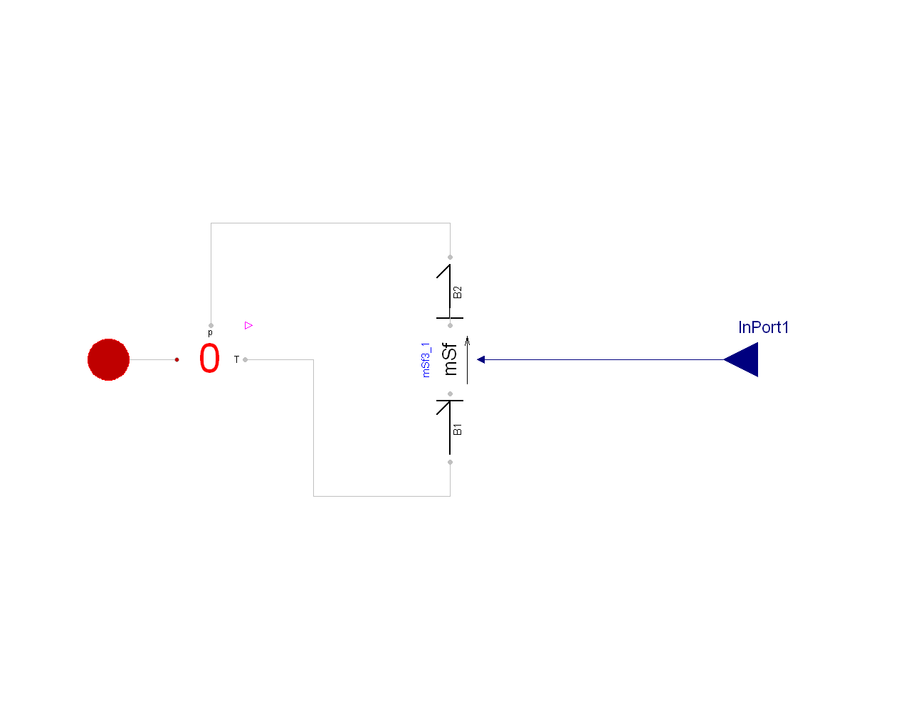
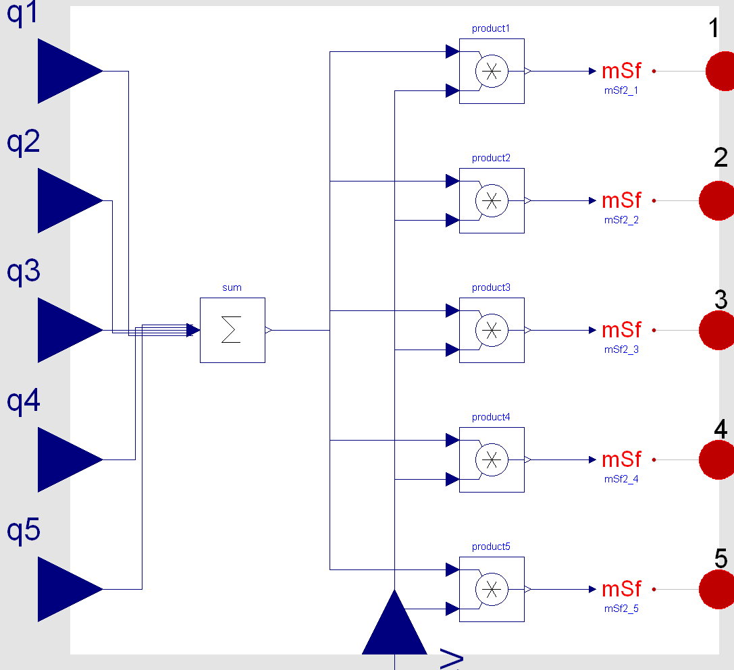
Modeling Chemical Reactions Using Bond Graphs
Volume Distribution (calculated)
2

Slide 13
Modeling Chemical Reactions Using Bond Graphs
Equilibrium and Parallel Reactions
Chemical reactions are reversible, i.e. for each reaction, there exists a reverse reaction, such that
R⁻¹ [ R(x) ] = x
The modeling does not care, whether ν ≥ 0 or ν < 0
Equilibrium reactions can be built using one ChR-Element
In praxis it is easier to use two separate ChR-Elements, as the determination of n depends on the Educts
The linearity of the network allows to superpose different reactions

Slide 14
Example: Hydrogen-Bromine-Synthesis
Reaction Equations and Network

Slide 15
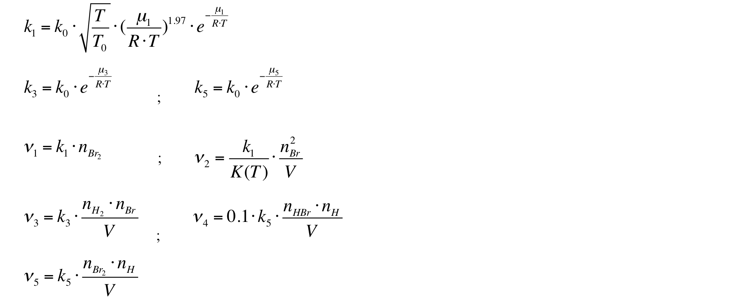
Modeling Chemical Reactions Using Bond Graphs
Example: Reaction and Molar Flow Rate Formulas

Slide 16
Volume and heat distribution
Thermo-bond to η/ν-bond transformation
Chemical reactors
Connection to outside
State vector
CF-Elements with HVEs
Chemical reaction network
Collection of reaction enthalpy

Slide 17
Example: Hydrogen-Bromine-Synthesis isochoric, outside condition: T=800 K, p= 101.3 hPa
HBr
Temperature
H₂ and Br₂
Molar fractions
Pressure
Radicals H and Br

Slide 18
Modeling Chemical Reactions Using Bond Graphs
Summary
Introduction of new bond variable η
Consistent and complete approach for modeling thermo dynamical phenomena using „true“ bond-graphs

Slide 19
Modeling Chemical Reactions Using Bond Graphs
Thanks a lot for your attention
Mille grazie del attenzione
Besten Dank für Ihre Aufmerksamkeit
Gracias por su atención
Merci beaucoup de votre attention
большо́е спаси́бо!

Slide 20


