Slide 1
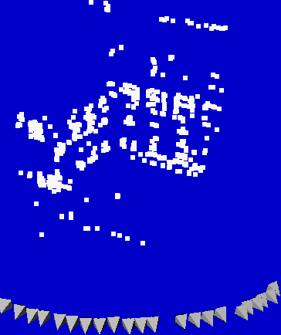
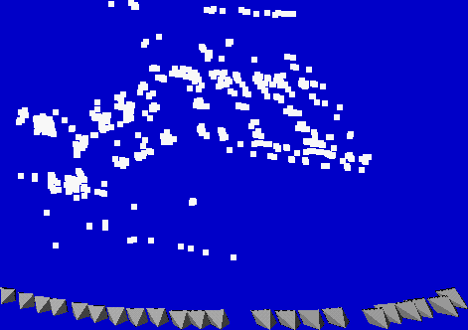
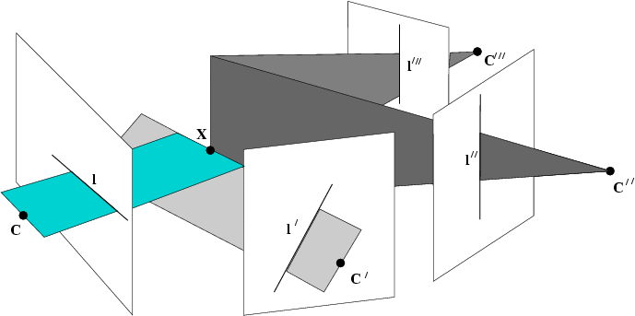
Self-calibration and multi-view geometry
Class 10
Read Chapter 6 and 3.2

Slide 2
3D photography course schedule
(tentative)
 | Lecture | Exercise
Sept 26 | Introduction | -
Oct. 3 | Geometry & Camera model | Camera calibration
Oct. 10 | Single View Metrology | Measuring in images
Oct. 17 | Feature Tracking/matching (Friedrich Fraundorfer) | Correspondence computation
Oct. 24 | Epipolar Geometry | F-matrix computation
Oct. 31 | Shape-from-Silhouettes (Li Guan) | Visual-hull computation
Nov. 7 | Stereo matching | Project proposals
Nov. 14 | Structured light and active range sensing | Papers
Nov. 21 | Structure from motion | Papers
Nov. 28 | Multi-view geometry and self-calibration | Papers
Dec. 5 | Shape-from-X | Papers
Dec. 12 | 3D modeling and registration | Papers
Dec. 19 | Appearance modeling and image-based rendering | Final project presentations

Slide 3
Self-calibration
Introduction
Self-calibration
Dual Absolute Quadric
Critical Motion Sequences

Slide 4
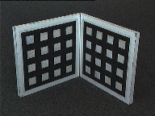
Motivation
Avoid explicit calibration procedure
  Complex procedure
  Need for calibration object
  Need to maintain calibration

Slide 5
Motivation
Allow flexible acquisition
  No prior calibration necessary
  Possibility to vary intrinsics
  Use archive footage

Slide 6
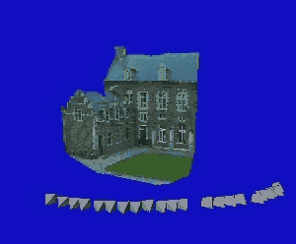
Projective ambiguity
Reconstruction from uncalibrated images
⇒ projective ambiguity on reconstruction

Slide 7
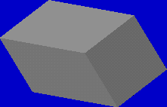
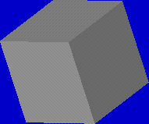
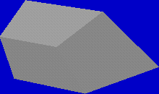
Stratification of geometry
Projective
Affine
Metric
15 DOF
7 DOF
absolute conic
angles, rel.dist.
12 DOF
plane at infinity
parallelism
More general
More structure

Slide 8
Constraints ?
Scene constraints
  Parallellism, vanishing points, horizon, ...
  Distances, positions, angles, ...
Unknown scene → no constraints
Camera extrinsics constraints
  Pose, orientation, ...
Unknown camera motion → no constraints
Camera intrinsics constraints
  Focal length, principal point, aspect ratio & skew
Perspective camera model too general
→ some constraints

Slide 9
Euclidean projection matrix
Factorization of Euclidean projection matrix
Intrinsics:
(camera geometry)
Extrinsics:
(camera motion)
Note: every projection matrix can be factorized,
but only meaningful for euclidean projection matrices

Slide 10
Constraints on intrinsic parameters
Constant
  e.g. fixed camera:
Known
  e.g. rectangular pixels:
  square pixels:
  principal point known:

Slide 11
Self-calibration
Upgrade from projective structure to metric structure using constraints on intrinsic camera parameters
  Constant intrinsics
  Some known intrinsics, others varying
  Constraints on intrincs and restricted motion
    (e.g. pure translation, pure rotation, planar motion)
(Faugeras et al. ECCV´92, Hartley´93,
Triggs´97, Pollefeys et al. PAMI´99, ...)
(Heyden&Astrom CVPR´97, Pollefeys et al. ICCV´98,...)
(Moons et al.´94, Hartley ´94, Armstrong ECCV´96, ...)

Slide 12
A counting argument
To go from projective (15DOF) to metric (7DOF) at least 8 constraints are needed
Minimal sequence length should satisfy
Independent of algorithm
Assumes general motion (i.e. not critical)

Slide 13
Outline
Introduction
Self-calibration
Dual Absolute Quadric
Critical Motion Sequences

Slide 14
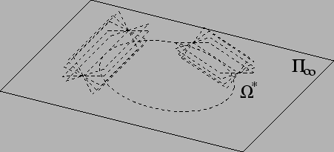
The Dual Absolute Quadric
The absolute dual quadric Ω*∞ is a fixed conic under the projective transformation H iff H is a similarity
8 dof
plane at infinity π∞ is the nullvector of Ω∞
Angles:

Slide 15
Absolute Dual Quadric and Self-calibration
Eliminate extrinsics from equation
Equivalent to projection of Dual Abs.Quadric
Dual Abs.Quadric also exists in projective world
Transforming world so that
reduces ambiguity to similarity

Slide 16
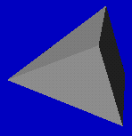
Absolute Dual Quadric and Self-calibration
Projection equation:
Ω*
Translate constraints on K through projection equation to constraints on Ω*
ω*
projection
constraints
Absolute conic = calibration object which is
always present but can only be observed
through constraints on the intrinsics

Slide 17
Constraints on ω*∞
condition
constraint
type
#constraints
Zero skew |  | quadratic | m
Principal point |  | linear | 2m
Zero skew (& p.p.) |  | linear | m
Fixed aspect ratio (& p.p.& Skew) |  | quadratic | m-1
Known aspect ratio (& p.p.& Skew) |  | linear | m
Focal length (& p.p. & Skew) |  | linear | m

Slide 18
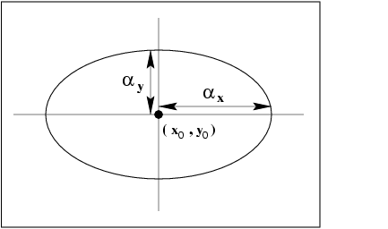
Linear algorithm
(Pollefeys et al.,ICCV´98/IJCV´99)
Assume everything known, except focal length
Yields 4 constraint per image
Note that rank-3 constraint is not enforced

Slide 19
Linear algorithm revisited
(Pollefeys et al., ECCV‘02)
Weighted linear equations
assumptions

Slide 20
Projective to metric
Compute T from
using eigenvalue decomposition of
and then obtain metric reconstruction as

Slide 21
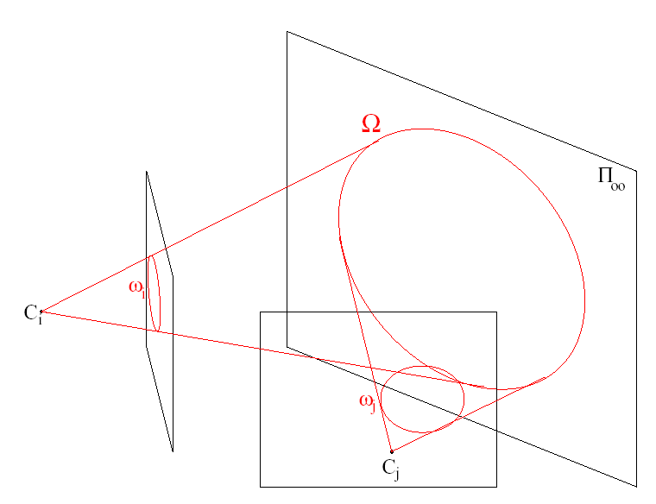
Alternatives:
(Dual) image of absolute conic
Equivalent to Absolute Dual Quadric
Practical when H∞ can be computed first
  Pure rotation (Hartley’94, Agapito et al.’98,’99)
  Vanishing points, pure translations, modulus constraint, …

Slide 22
Note that in the absence of skew the IAC
can be more practical than the DIAC!

Slide 23
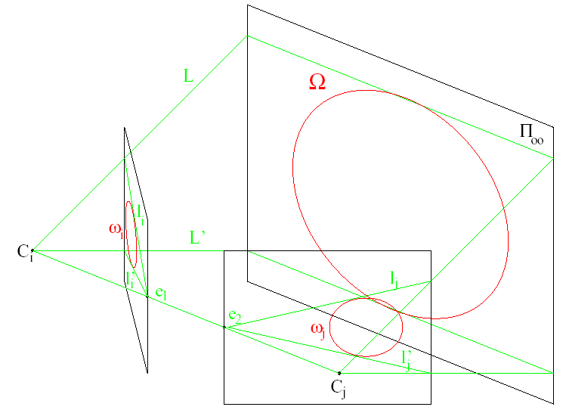
Kruppa equations
    Limit equations to epipolar geometry
    Only 2 independent equations per pair
    But independent of plane at infinity

Slide 24
Refinement
Metric bundle adjustment
Enforce constraints or priors
on intrinsics during minimization
(this is „self-calibration“ for photogrammetrist)

Slide 25
Outline
Introduction
Self-calibration
Dual Absolute Quadric
Critical Motion Sequences

Slide 26
Critical motion sequences
(Sturm, CVPR´97, Kahl, ICCV´99, Pollefeys,PhD´99)
Self-calibration depends on camera motion
Motion sequence is not always general enough
Critical Motion Sequences have more than one potential absolute conic satisfying all constraints
Possible to derive classification of CMS

Slide 27
Critical motion sequences: constant intrinsic parameters
Most important cases for constant intrinsics
Critical motion type | ambiguity
pure translation | affine transformation (5DOF)
pure rotation | arbitrary position for Π∞ (3DOF)
orbital motion | proj.distortion along rot. axis (2DOF)
planar motion | scaling axis ⊥ plane (1DOF)
Note relation between critical motion sequences and restricted motion algorithms

Slide 28
Critical motion sequences: varying focal length
Most important cases for varying focal length (other parameters known)
Critical motion type | ambiguity
pure rotation | arbitrary position for Π∞ (3DOF)
forward motion | proj.distortion along opt. axis (2DOF)
translation and rot. about opt. axis | scaling optical axis (1DOF)
hyperbolic and/or elliptic motion | one extra solution

Slide 29
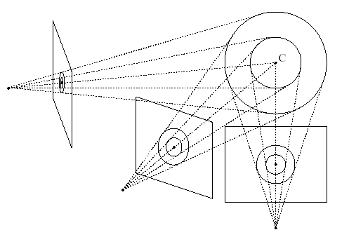
Critical motion sequences: algorithm dependent
Additional critical motion sequences can exist for some specific algorithms
  when not all constraints are enforced
  (e.g. not imposing rank 3 constraint)
  Kruppa equations/linear algorithm: fixating a point
Some spheres also project to circles located in the image and hence satisfy all the linear/kruppa self-calibration constraints

Slide 30
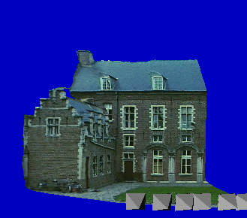
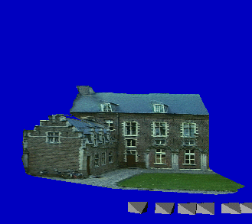
Non-ambiguous new views for CMS
(Pollefeys,ICCV´01)
restrict motion of virtual camera to CMS
use (wrong) computed camera parameters

Slide 31
Multi-view geometry

Slide 32
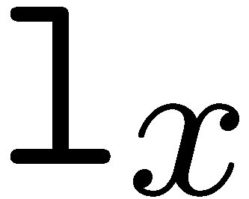
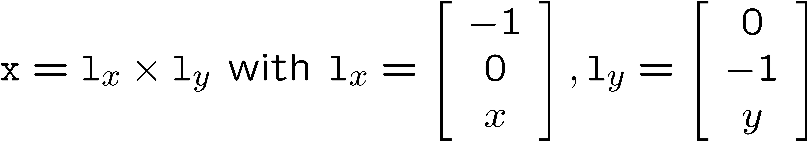

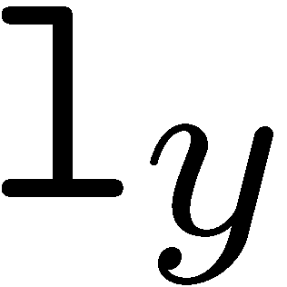
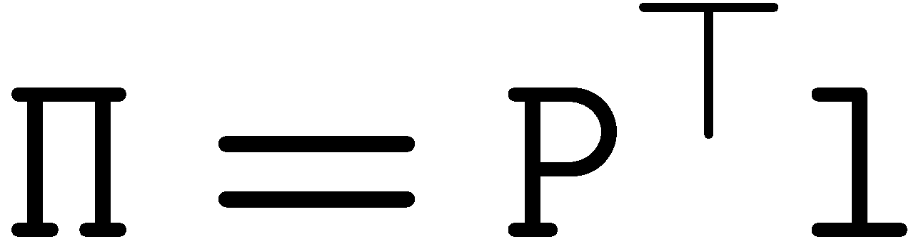
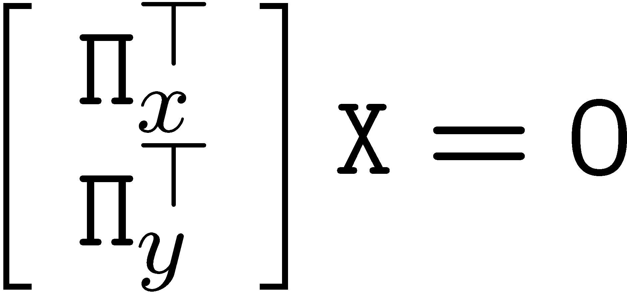
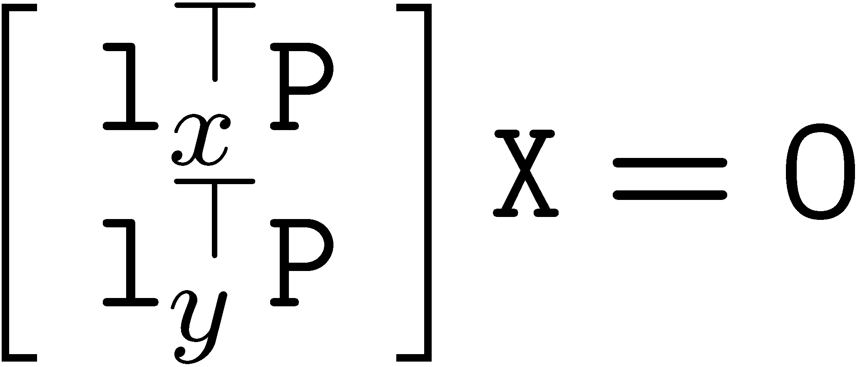
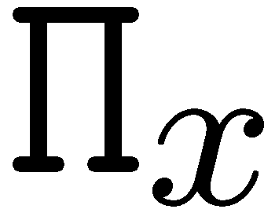
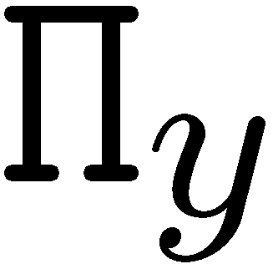
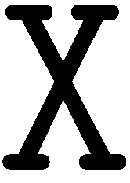
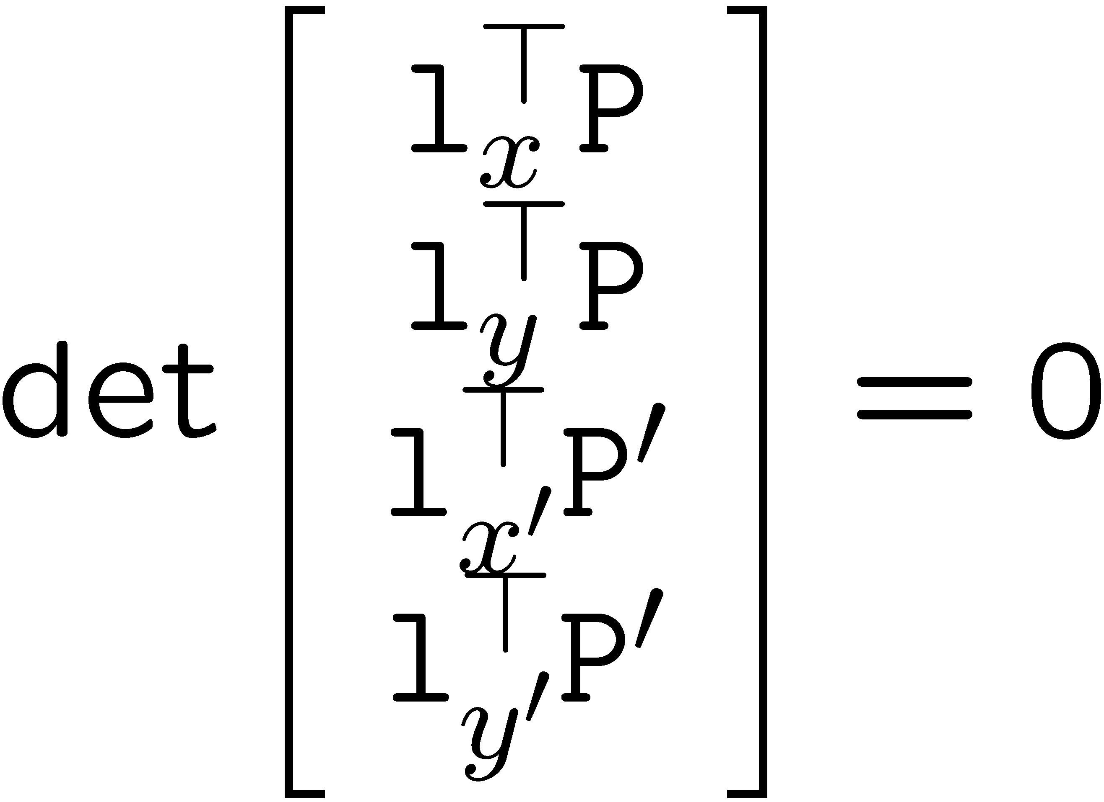
Backprojection
Represent point as intersection of row and column
Condition for solution?
Useful presentation for deriving and understanding multiple view geometry
(notice 3D planes are linear in 2D point coordinates)

Slide 33
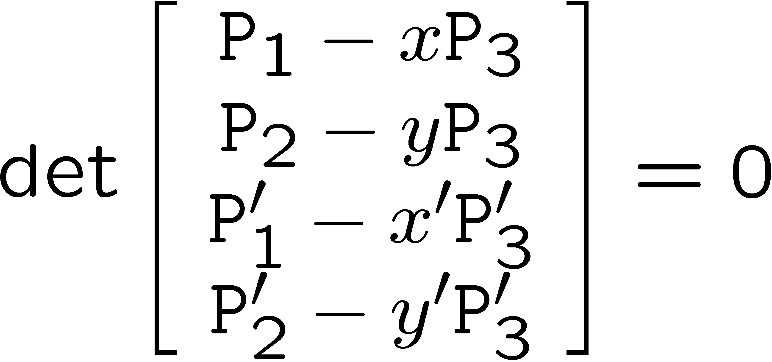
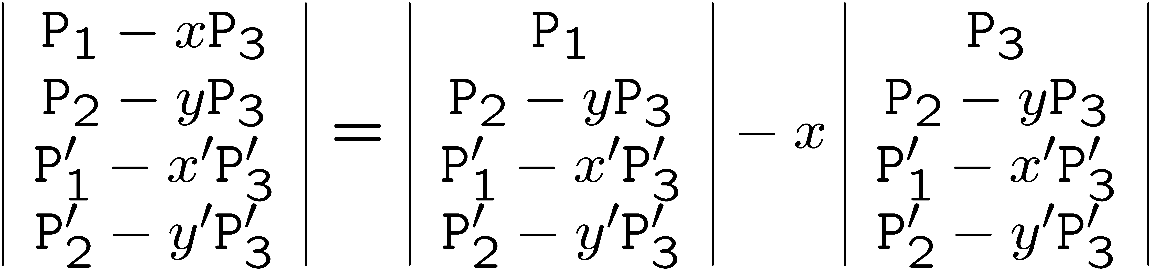
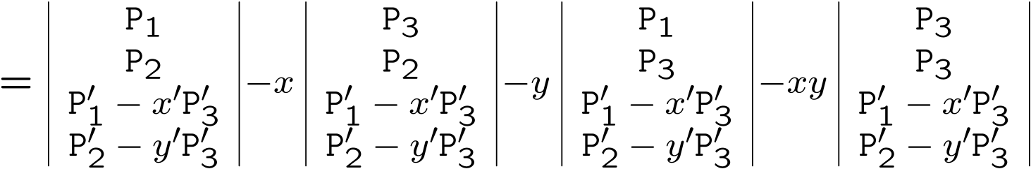

Multi-view geometry
(intersection constraint)
(multi-linearity of determinants)
(= epipolar constraint!)
(counting argument: 11x2-15=7)

Slide 34
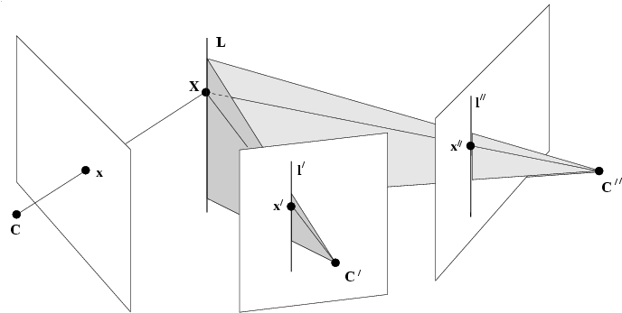
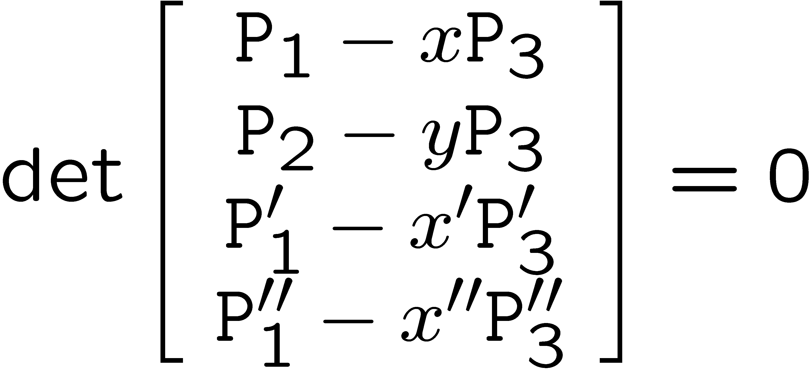
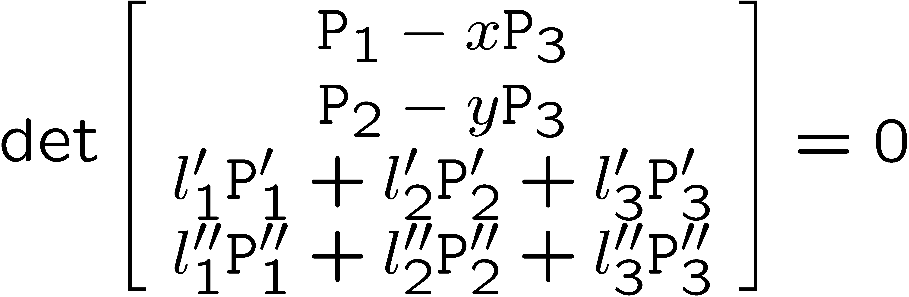
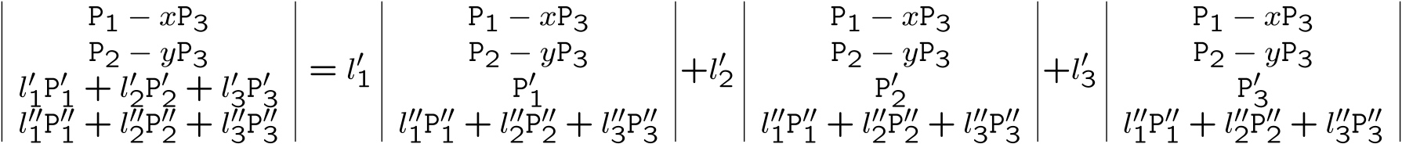
Multi-view geometry
(multi-linearity of determinants)
(3x3x3=27 coefficients)
(= trifocal constraint!)
(counting argument: 11x3-15=18)

Slide 35
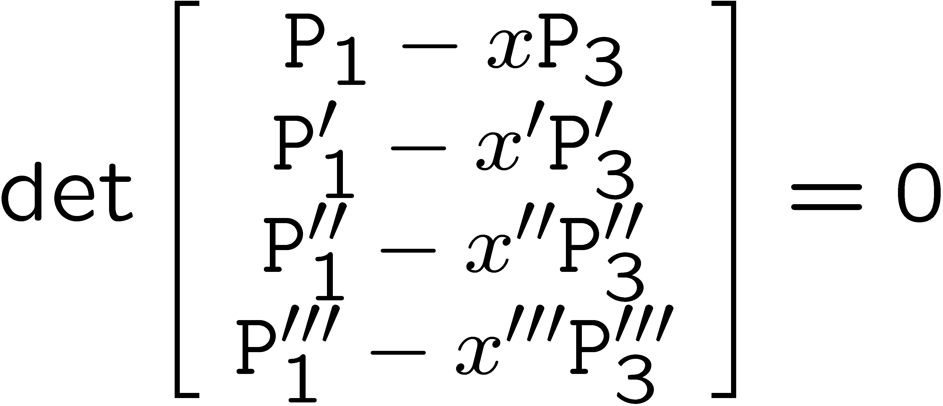
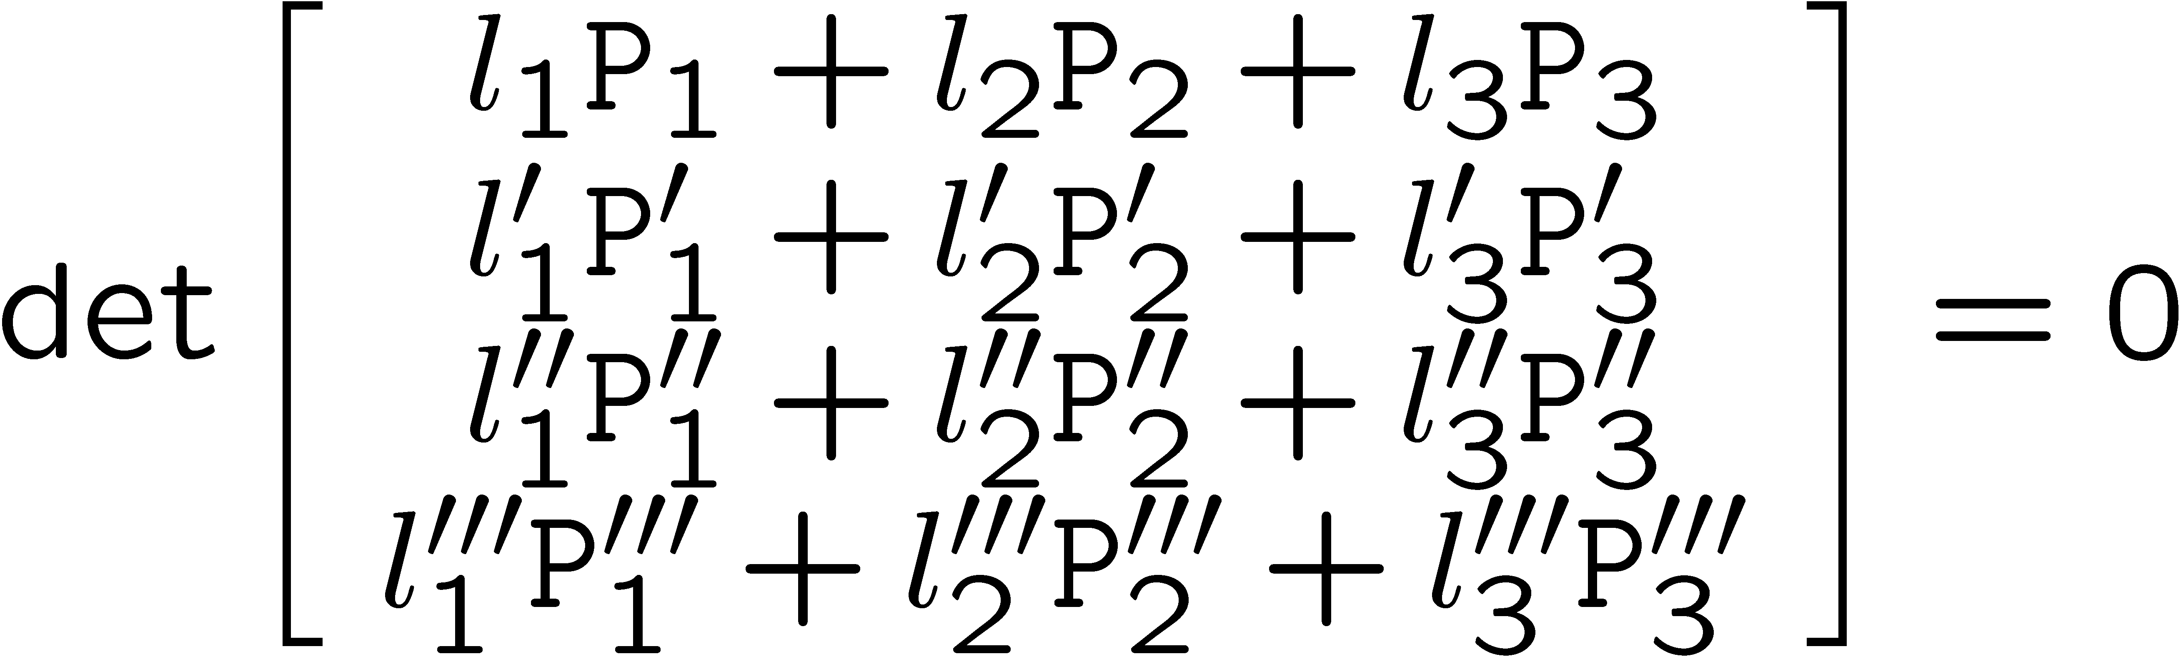
Multi-view geometry
(multi-linearity of determinants)
(3x3x3x3=81 coefficients)
(= quadrifocal constraint!)
(counting argument: 11x4-15=29)

Slide 36
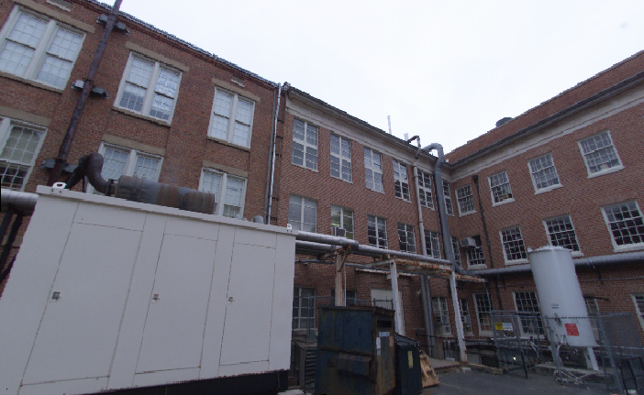
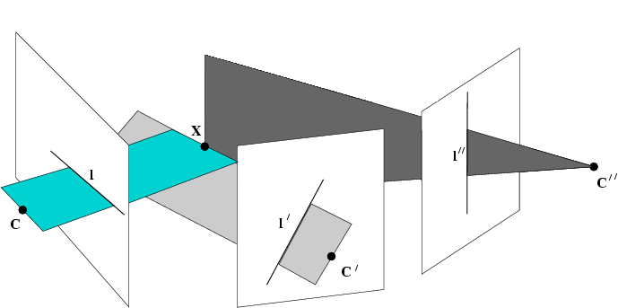
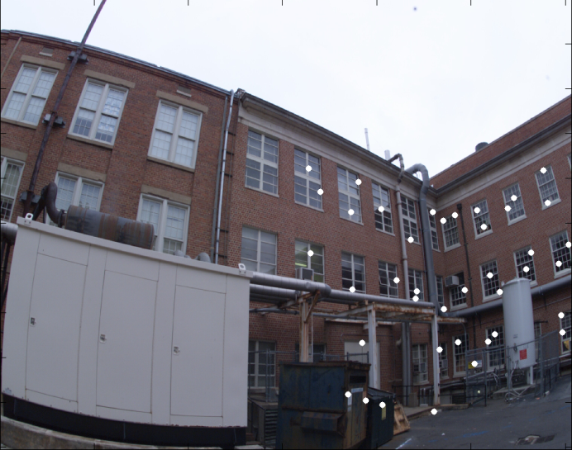
from perspective to omnidirectional cameras
3 constraints allow to reconstruct 3D point
perspective camera
(2 constraints / feature)
more constraints also tell something about cameras
l=(y,-x)
(x,y)
(0,0)
radial camera (uncalibrated)
(1 constraints / feature)
multilinear constraints known as epipolar, trifocal and quadrifocal constraints

Slide 37
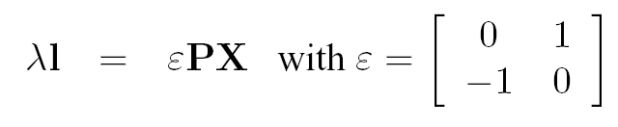
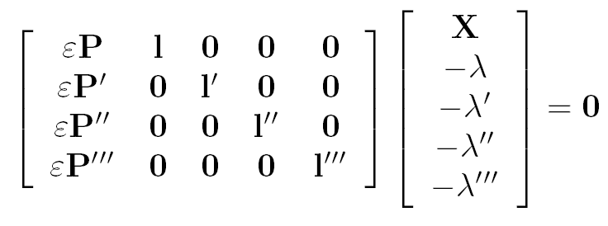

Quadrifocal constraint

Slide 38
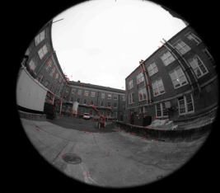
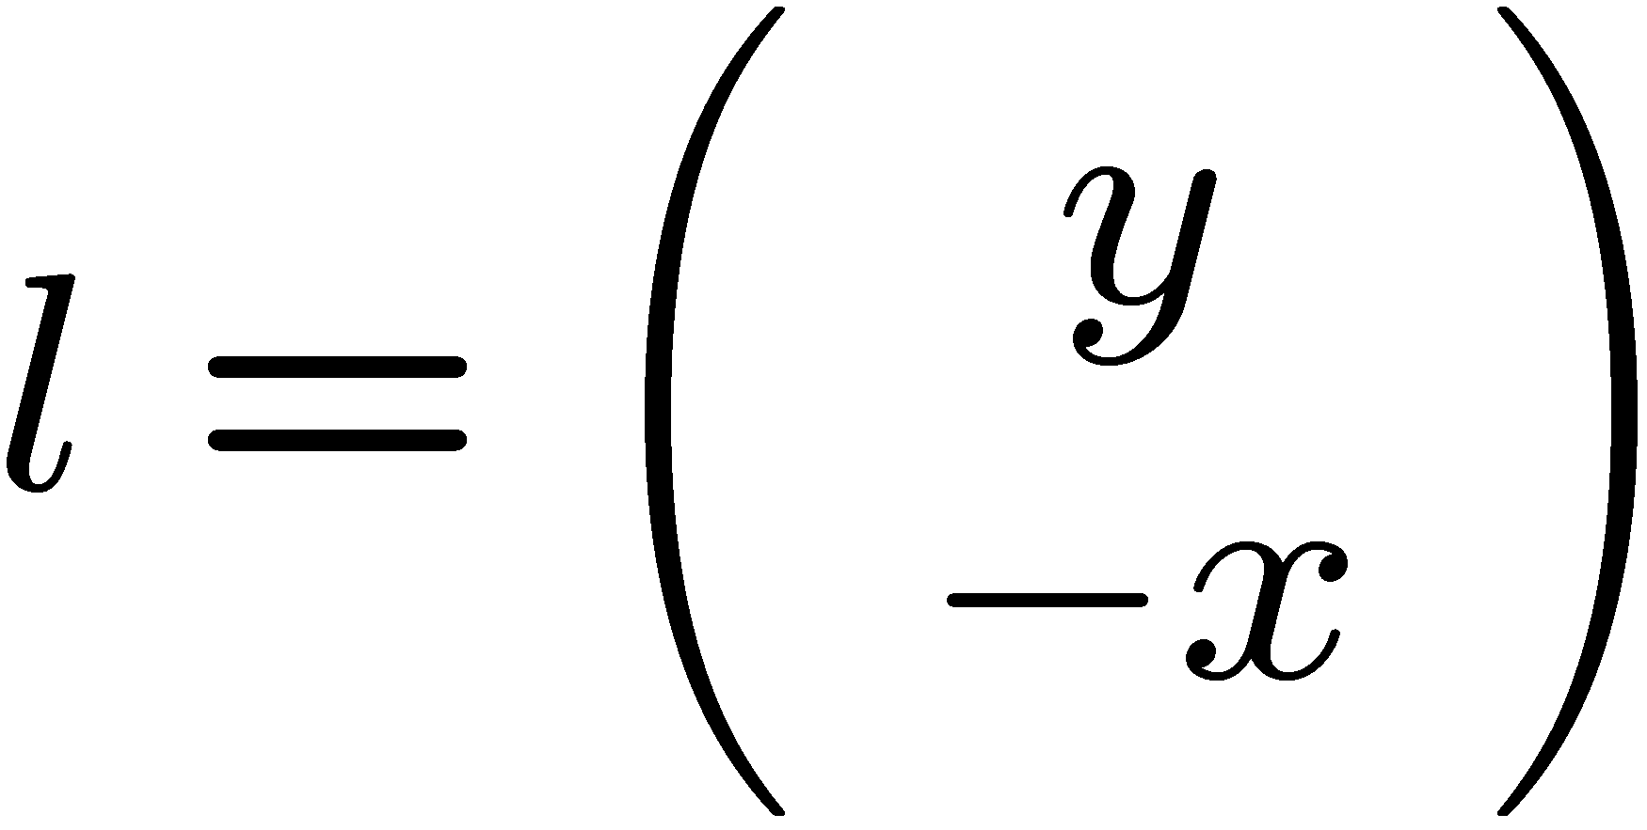
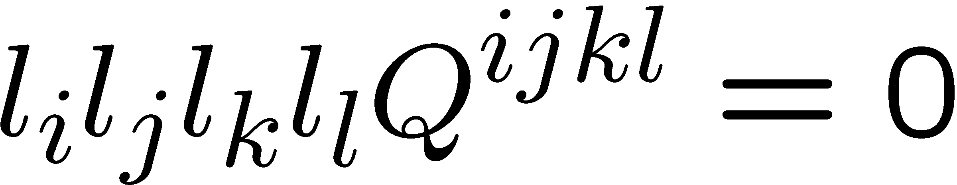
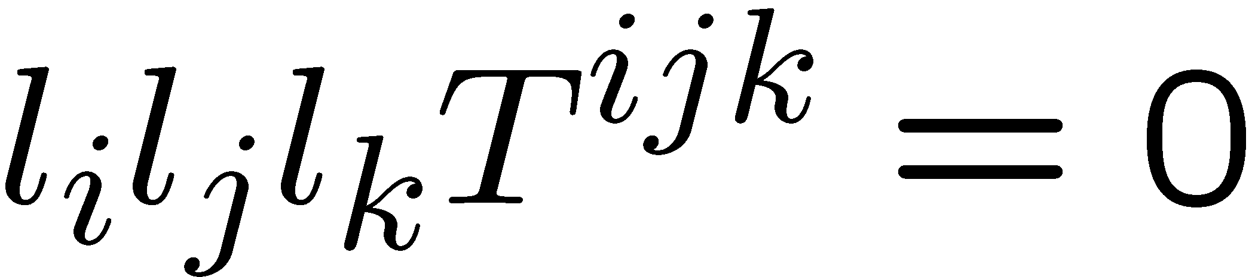
Radial quadrifocal tensor
(x,y)
Linearly compute radial quadrifocal tensor Q^{ijkl} from 15 pts in 4 views
Reconstruct 3D scene and use it for calibration
(2x2x2x2 tensor)
Not easy for real data, hard to avoid degenerate cases (e.g. 3 optical axes intersect in single point). However, degenerate case leads to simpler 3 view algorithm for pure rotation
Radial trifocal tensor T^{ijk} from 7 points in 3 views
Reconstruct 2D panorama and use it for calibration
(2x2x2 tensor)

Slide 39
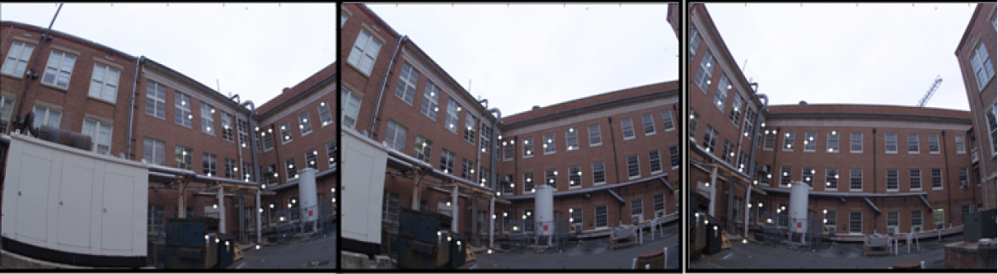
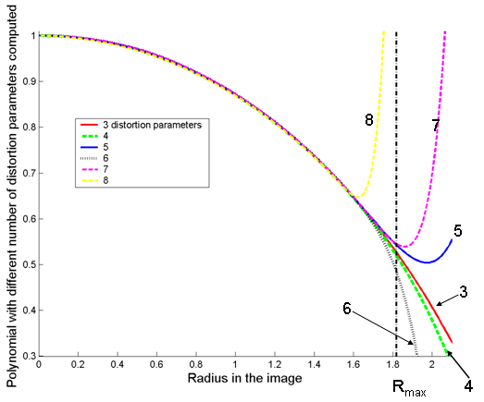
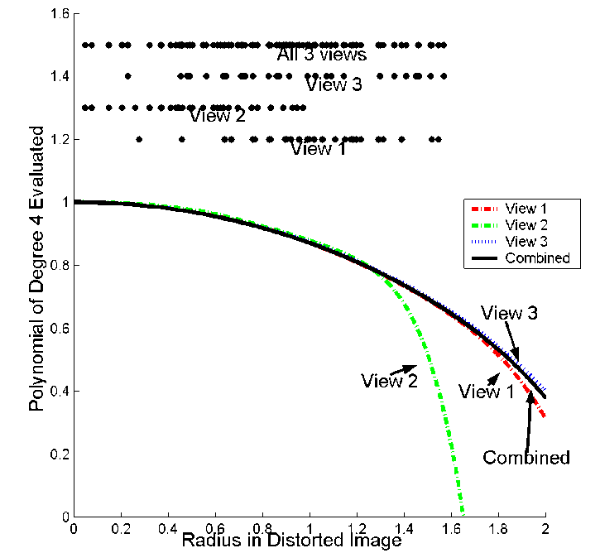

Dealing with Wide FOV Camera
(Thirthala and Pollefeys CVPR05)
Two-step linear approach to compute radial distortion
Estimates distortion polynomial of arbitrary degree
estimated distortion
(4-8 coefficients)
undistorted image

Slide 40
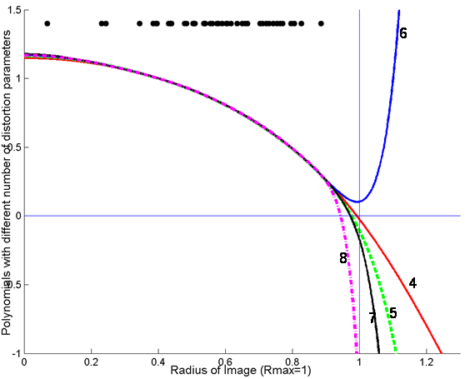
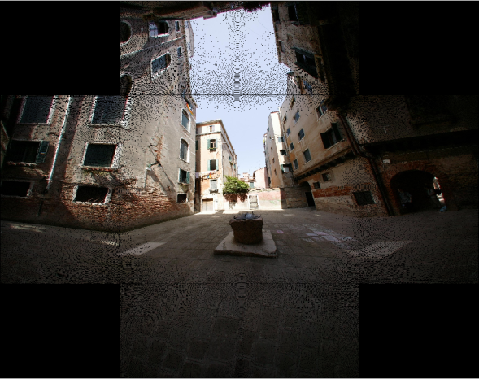
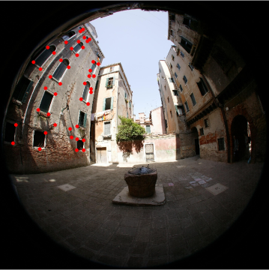
Dealing with Wide FOV Camera
(Thirthala and Pollefeys CVPR05)
Two-step linear approach to compute radial distortion
Estimates distortion polynomial of arbitrary degree
unfolded cubemap
estimated distortion
(4-8 coefficients)

Slide 41





Non-parametric distortion calibration
(Thirthala and Pollefeys, ICCV’05)
Models fish-eye lenses, cata-dioptric systems, etc.
angle
normalized radius

Slide 42





Non-parametric distortion calibration
(Thirthala and Pollefeys, ICCV’05)
Models fish-eye lenses, cata-dioptric systems, etc.
results
90º
angle
normalized radius

Slide 43



Synthetic quadrifocal tensor example
Perspective
Fish-eye
Spherical mirror
Hyperbolic mirror

Slide 44

Perspective
Fish-eye

Slide 45
Spherical mirror
Hyperbolic mirror

Slide 46




Next class: shape-from-X
Photometric stereo
Shape from texture
Shape from focus/defocus

