Slide 1
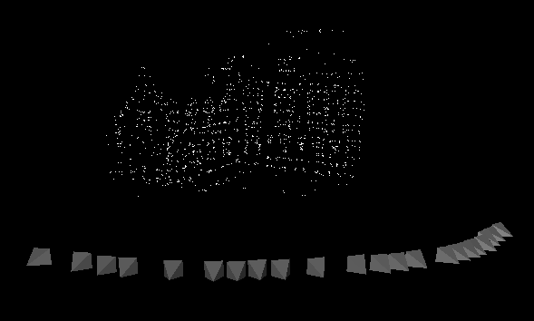
Structure from motion Class 9
Read Chapter 5

Slide 2
3D photography course schedule (tentative)
 | Lecture | Exercise
Sept 26 | Introduction | -
Oct. 3 | Geometry & Camera model | Camera calibration
Oct. 10 | Single View Metrology | Measuring in images
Oct. 17 | Feature Tracking/matching (Friedrich Fraundorfer) | Correspondence computation
Oct. 24 | Epipolar Geometry | F-matrix computation
Oct. 31 | Shape-from-Silhouettes (Li Guan) | Visual-hull computation
Nov. 7 | Stereo matching | Project proposals
Nov. 14 | Structured light and active range sensing | Papers
Nov. 21 | Structure from motion | Papers
Nov. 28 | Multi-view geometry and self-calibration | Papers
Dec. 5 | Shape-from-X | Papers
Dec. 12 | 3D modeling and registration | Papers
Dec. 19 | Appearance modeling and image-based rendering | Final project presentations

Slide 3
Today’s class
Structure from motion
factorization
sequential
bundle adjustment

Slide 4
Factorization
Factorise observations in structure of the scene and motion/calibration of the camera
Use all points in all images at the same time
Affine factorisation
Projective factorisation

Slide 5
Affine camera
The affine projection equations are
how to find the origin? or for that matter a 3D reference point?
affine projection preserves center of gravity

Slide 6
Orthographic factorization
(Tomasi Kanade’92)
The ortographic projection equations are
where
All equations can be collected for all i and j
where
Note that P and M are resp. 2mx3 and 3xn matrices and therefore the rank of m is at most 3

Slide 7
Orthographic factorization
(Tomasi Kanade’92)
Factorize m through singular value decomposition
An affine reconstruction is obtained as follows
Closest rank-3 approximation yields MLE!

Slide 8
Orthographic factorization
(Tomasi Kanade’92)
Factorize m through singular value decomposition
An affine reconstruction is obtained as follows
A metric reconstruction is obtained as follows
Where A is computed from
3 linear equations per view on symmetric matrix C (6DOF)
A can be obtained from C through Cholesky factorisation
and inversion

Slide 9
Examples
Tomasi Kanade’92,
Poelman & Kanade’94

Slide 10
Examples
Tomasi Kanade’92,
Poelman & Kanade’94

Slide 11
Examples
Tomasi Kanade’92,
Poelman & Kanade’94

Slide 12
Examples
Tomasi Kanade’92,
Poelman & Kanade’94

Slide 13
Perspective factorization
The camera equations
for a fixed image i can be written in matrix form as
where

Slide 14
Perspective factorization
All equations can be collected for all i as
where
In these formulas m are known, but Λ_{i},P and M are unknown
Observe that PM is a product of a 3mx4 matrix and a 4xn matrix, i.e. it is a rank-4 matrix

Slide 15
Perspective factorization algorithm
Assume that Λ_{i} are known, then PM is known.
Use the singular value decomposition
PM=UΣ V^{T}
In the noise-free case
Σ=diag(σ₁,σ₂,σ₃,σ₄,0, … ,0)
and a reconstruction can be obtained by setting:
P=the first four columns of UΣ.
M=the first four rows of V.

Slide 16
Iterative perspective factorization
When Λ_{i} are unknown the following algorithm can be used:
1. Set λ_{ij}=1 (affine approximation).
2. Factorize PM and obtain an estimate of P and M. If σ₅ is sufficiently small then STOP.
3. Use m, P and M to estimate Λ_{i} from the camera equations (linearly) m_{i} Λ_{i}=P_{i}M
4. Goto 2.
In general the algorithm minimizes the proximity measure P(Λ,P,M)=σ₅
Note that structure and motion recovered up to an arbitrary projective transformation

Slide 17
Further Factorization work
Factorization with uncertainty
Factorization for dynamic scenes
(Irani & Anandan, IJCV’02)
(Costeira and Kanade ‘94)
(Bregler et al. ‘00, Brand ‘01)
(Yan and Pollefeys, ‘05/’06)

Slide 18
practical structure and motion recovery from images
Obtain reliable matches using matching or tracking and 2/3-view relations
Compute initial structure and motion
Refine structure and motion
Auto-calibrate
Refine metric structure and motion

Slide 19
Sequential Structure and Motion Computation
Initialize Motion
(P₁,P₂ compatibel with F)
Initialize Structure
(minimize reprojection error)
Extend motion
(compute pose through matches
seen in 2 or more previous views)
Extend structure
(Initialize new structure,
refine existing structure)

Slide 20
Computation of initial structure and motion
according to Hartley and Zisserman
“this area is still to some extend a black-art”
All features not visible in all images
No direct method (factorization not applicable)
Build partial reconstructions and assemble
(more views is more stable, but less corresp.)
1) Sequential structure and motion recovery
2) Hierarchical structure and motion recovery

Slide 21
Sequential structure and motion recovery
Initialize structure and motion from two views
For each additional view
Determine pose
Refine and extend structure
Determine correspondences robustly by jointly estimating matches and epipolar geometry

Slide 22
Initial structure and motion
Epipolar geometry ↔ Projective calibration
compatible with F
Yields correct projective camera setup
(Faugeras´92,Hartley´92)
Obtain structure through triangulation
Use reprojection error for minimization
Avoid measurements in projective space

Slide 23
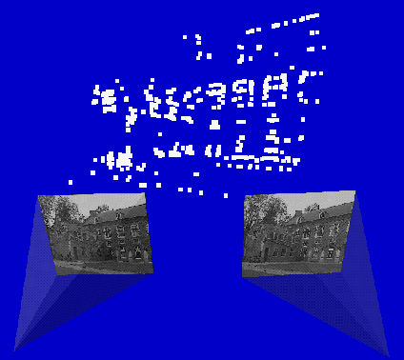
Determine pose towards existing structure
M
2D-3D
2D-3D
m_{i+1}
m_{i}
2D-2D
new view
Compute Pi+1 using robust approach (6-point RANSAC)
Extend and refine reconstruction

Slide 24
Compute P with 6-point RANSAC
Generate hypothesis using 6 points
Count inliers
Projection error
3D error
Back-projection error
Re-projection error
Projection error with covariance
Expensive testing? Abort early if not promising
Verify at random, abort if e.g. P(wrong)>0.95
(Chum and Matas, BMVC’02)

Slide 25
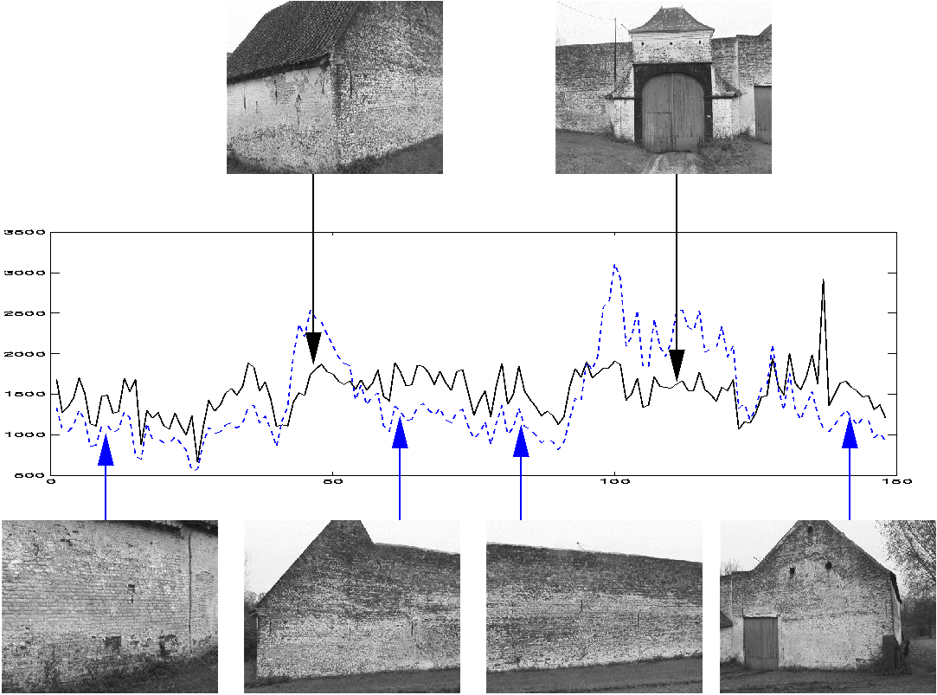
Dealing with dominant planar scenes
(Pollefeys et al., ECCV‘02)
USaM fails when common features are all in a plane
Solution: part 1 Model selection to detect problem

Slide 26
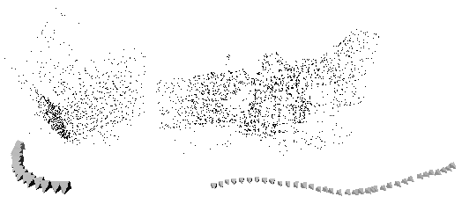
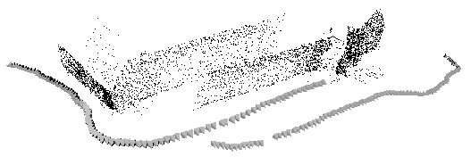
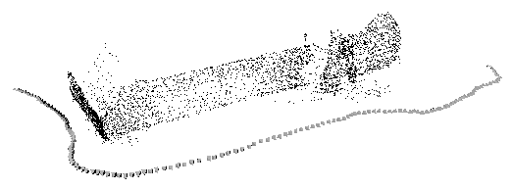
Dealing with dominant planar scenes
(Pollefeys et al., ECCV‘02)
USaM fails when common features are all in a plane
Solution: part 2 Delay ambiguous computations
until after self-calibration
(couple self-calibration over all 3D parts)

Slide 27
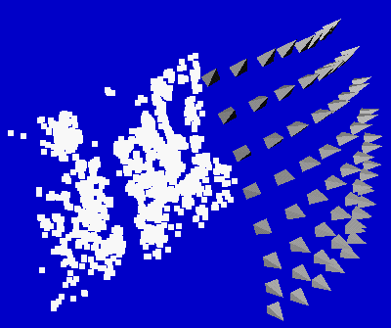
Non-sequential image collections
Problem:
Features are lost and reinitialized as new features
3792 points
Solution:
Match with other close views
4.8im/pt
64 images

Slide 28
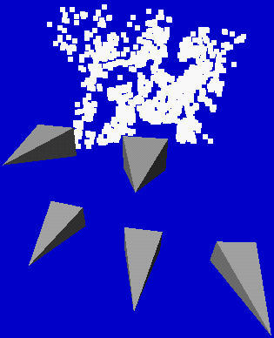
Relating to more views
For every view i
Extract features
Compute two view geometry i-1/i and matches
Compute pose using robust algorithm
For all close views k
Compute two view geometry k/i and matches
Infer new 2D-3D matches and add to list
Refine pose using all 2D-3D matches
Refine existing structure
Initialize new structure
For every view i
Extract features
Compute two view geometry i-1/i and matches
Compute pose using robust algorithm
Refine existing structure
Initialize new structure
Problem:
find close views in projective frame

Slide 29
Determining close views
If viewpoints are close then most image changes can be modelled through a planar homography
Qualitative distance measure is obtained by looking at the residual error on the best possible planar homography
Distance =

Slide 30
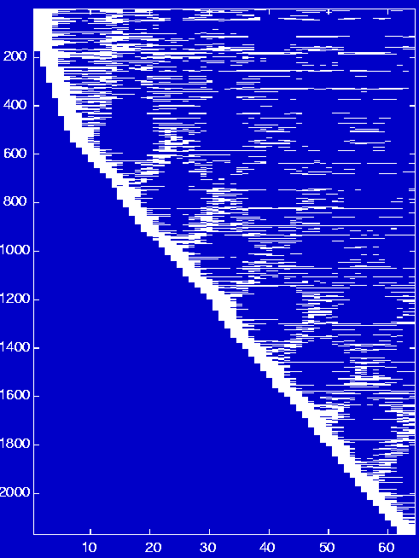
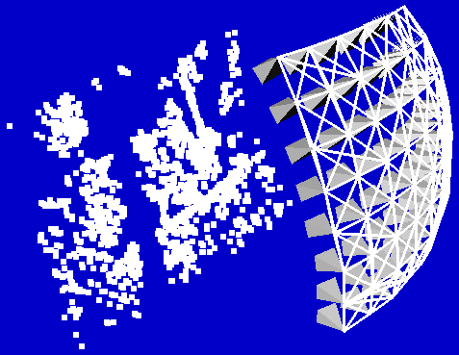
Non-sequential image collections (2)
3792 points
2170 points
9.8im/pt
64 images
4.8im/pt
64 images

Slide 31
Hierarchical structure and motion recovery
Compute 2-view
Compute 3-view
Stitch 3-view reconstructions
Merge and refine reconstruction
F
T
H
PM

Slide 32
Stitching 3-view reconstructions
Different possibilities
1. Align (P₂,P₃) with (P’₁,P’₂)
2. Align X,X’ (and C’C’)
3. Minimize reproj. error
4. MLE (merge)

Slide 33
Refining structure and motion
Minimize reprojection error
Maximum Likelyhood Estimation (if error zero-mean Gaussian noise)
Huge problem but can be solved efficiently (Bundle adjustment)

Slide 34
Non-linear least-squares
Newton iteration
Levenberg-Marquardt
Sparse Levenberg-Marquardt

Slide 35
Newton iteration
Taylor approximation
Jacobian
normal eq.

Slide 36
Levenberg-Marquardt
Normal equations
Augmented normal equations
accept
solve again
λ small ~ Newton (quadratic convergence)
λ large ~ descent (guaranteed decrease)

Slide 37
Levenberg-Marquardt
Requirements for minimization
Function to compute f
Start value P₀
Optionally, function to compute J
(but numerical ok, too)

Slide 38
Sparse Levenberg-Marquardt
complexity for solving
prohibitive for large problems
(100 views 10,000 points ~30,000 unknowns)
Partition parameters
partition A
partition B (only dependent on A and itself)

Slide 39
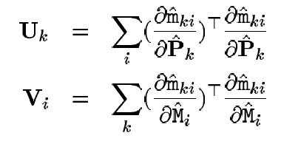
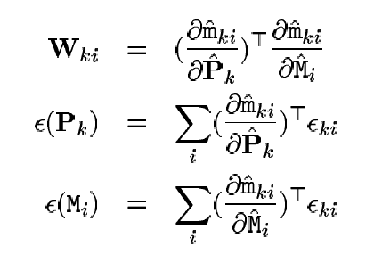
Sparse bundle adjustment
residuals:
normal equations:
with
note: tie points should be in partition A

Slide 40
Sparse bundle adjustment
normal equations:
modified normal equations:
solve in two parts:

Slide 41
Sparse bundle adjustment
Jacobian of has sparse block structure
P₁
P₂
P₃
M
U₁
im.pts.
view 1
U₂
W
U₃
W^{T}
V
12xm
3xn
(in general
much larger)
Needed for non-linear minimization

Slide 42
Sparse bundle adjustment
Eliminate dependence of camera/motion parameters on structure parameters
Note in general 3n >> 11m
U-WV⁻¹W^{T}
Allows much more efficient computations
e.g. 100 views,10000 points,
solve ±1000x1000, not ±30000x30000
W^{T}
V
11xm
3xn
Often still band diagonal
use sparse linear algebra algorithms

Slide 43
Sparse bundle adjustment
normal equations:
modified normal equations:
solve in two parts:

Slide 44
Sparse bundle adjustment
Covariance estimation

Slide 45
Related problems
On-line structure from motion and SLaM (Simultaneous Localization and Mapping)
Kalman filter (linear)
Particle filters (non-linear)

Slide 46
Open challenges
Large scale structure from motion
Complete building
Complete city

Slide 47
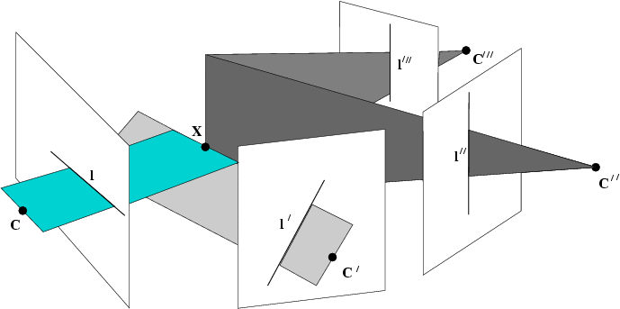
Next class: Multi-View Geometry and Self-Calibration

